Slide 1
Lessons Learnt from implementing and embedding an enterprise architecture team at National Wealth Management
Chris Tham
Manager, Architecture
National Wealth Management

Slide 2
Table of Contents
Introduction
Evolution of the architecture function from 1998-2003
Business alignment
Engaging with other areas of the IT organization
Enterprise architecture vs project/solution focus
Architecture governance
  How to ensure the organization positively advances to the target architecture
Enterprise architecture framework
A “federated” approach to enterprise architecture

Slide 3

Overview of National Wealth Management
Broad portfolio of Financial Services across:
  Australia
  New Zealand.
  Europe
  Asia
Products for Retail and corporate customers:
  Financial planning and advice services
  Wealth creation
    investments, financial planning, private banking
  Wealth protection
    Insurance
  Succession solutions
    Superannuation
Products for Corporate and Institutional customers:
  Outsourced investment
  Superannuation
  Employee benefit solutions
Created through the integration of
  National’s financial service and funds management businesses
  MLC Group.
Internationally, as at 30th September 2002, Wealth Management had over:
  2.8 million customers
  $64.5 billion on behalf of retail and corporate customers.
  3, 300 aligned and salaried advisers who choose to partner with Wealth Management.
  5,400 employees
Notes:
The Wealth Management division of the National operates a broad portfolio of financial services businesses across Australia, Europe, Asia and New Zealand.
Through its network of aligned self-employed, salaried and external financial advisers, Wealth Management provides financial planning and advice services, wealth creation (investments, financial planning, private banking), wealth protection (insurance) and succession (superannuation) solutions to retail and corporate customers. It also provides corporate and institutional clients with outsourced investment, superannuation and employee benefit solutions.
Wealth Management was created through the integration of the National’s financial service and funds management businesses with the MLC Group, which the National acquired in June 2000. MLC’s 'manager of managers' investment approach, coupled with Wealth Management’s multi-channel distribution and advice capabilities, provides a strong competitive differentiator for the division.
Internationally, as at 30th September 2002, Wealth Management had over:
2.8 million customers
$64.5 billion on behalf of retail and corporate customers.
3, 300 aligned and salaried advisers who choose to partner with Wealth Management.
5,400 employees

Slide 4
History of MLC
Citizens' Life Assurance Company Ltd established in 1896 at Sydney by a group led by James P Garvan.
Citizens' Life Assurance took over the Mutual Life Association of Australasia and name changed to MLC in 1908.
Lend Lease Corporation Limited formed as a public company in 1958 with Civil & Civic being the largest shareholder.
MLC provided finance for Lend Lease's first project, the North Shore Medical Centre.
Lend Lease made a successful (50 per cent) partial takeover of MLC, its largest shareholder in 1982.
MLC became a wholly owned subsidiary of Lend Lease by 1995.
MLC became part of the National in July 2000 creating Australia’s largest integrated retail fund manager.
Notes:
In 1896, the Citizens' Life Assurance Company Ltd was established in Sydney by a group led by James P Garvan.
In 1908 The Citizens' took over The Mutual Life Association of Australasia, company and the name of the amalgamated company became "The Mutual Life and Citizens' Assurance Company Limited". As a result the name MLC began.
In 1958 the directors of Civil & Civic had decided that a finance and investment company was needed, this was achieved by going to the Australian public for funds, so Lend Lease Corporation Limited was formed as a public company with Civil & Civic being the largest shareholder. MLC encouraged the formation of the new company and provided (by way of mortgage) the finance needed for Lend Lease's first project, the North Shore Medical Centre.
As confidence in the Lend Lease Group grew and the association developed, the MLC became one of the largest shareholders in Lend Lease. In 1982 Lend Lease made a successful (50 per cent) partial takeover of the MLC. By 1995, MLC became a wholly owned subsidiary of Lend Lease.
In July 2000, MLC became part of the National. At the time, the acquisition of MLC created Australia’s largest integrated retail fund manager (as ranked by ASSIRT in September 2000) with $29.3 billion in retail funds under management a 14.56% market share.

Slide 5
Overview of Information Technology at NWM
MLC IT was wholly outsourced to IBM GSA in the mid 1990s
MLC re established strategic control and management of IT in 1999
  Architecture was seen as one of the key areas to be “in sourced”
Business Technology (IT Function)
  Part of Corporate Devlopment and Business Technology which is also responsible for business strategy, mergers and acquisitions and business project services.
  Staff size of about 550 excluding outsourced functions and external service providers
  Infrastructure largely outsourced to IBM GSA
  Application Development done through a combination of internal resources and external partners
Additional IT functions associated with overseas joint ventures and subsidiaries:
  UK, New Zealand, Hong Kong, Indonesia and Thailand
Notes:
MLC IT was wholly outsourced to IBM GSA in the mid 1990s
In 1999 MLC reestablished strategic control and management of IT, and architecture was seen as one of the key areas to be “insourced”
The IT function is called “Business Technology” and resides in a organizational unit called “Corporate Development and Business Technology” which is also responsible for business strategy, mergers and acquisitions and business project services.
Size of Business Technology function is about 550, not including outsourced functions and external service providers
Infrastructure is largely outsourced to IBM GSA
Application Development is done through a combination of internal resources and external partners
In addition, there are IT functions associated with overseas joint ventures and subsidiaries in the UK, New Zealand, Hong Kong, Indonesia and Thailand
The architecture function in Business Technology was established in 1998 and currently contains six permanent employees and five contractors/seconded employees.

Slide 6
Evolution of the architecture team 1998-2003
Maturity
  Team size has grown from 1 to 12
  Self-assessed at Level 3 (Architecture Process Management) in META Architecture Improvement Matrix
  Positive feedback from recent risk audit reports
  Key Performance Indicator for Architecture includes “% of IT investment that contributes to advancing towards the target architecture” – this is currently measuring around 80%
Deliverables/Artefacts
  Initial focus on Enterprise Application Architecture and technology standards/preferred products
  Application Architecture went through at least three iterations over 1999-2001
  Current focus is on Data Architecture and Security framework/models/guidelines, as well as reference architectures (design patterns)
Role
  Initial focus on Enterprise Architecture function and delivering enterprise level artefacts (framework, strategy, principles, architectures)
  Focus in 2000-2001 is in establishing an architecture governance model and Solution Architecture role
  Current focus is on balancing between enterprise and solution architecture roles

Slide 7
NWM Enterprise Architecture Framework
WM Business and Technology
WM Enterprise Architectures
WM IT Portfolio
Gaps, issues
Systems
Business Strategy
Asset Lifecycle Plan
Aligns, is supported by
Application
Architecture
Data/Information
Architecture
Security
Architecture
Business Architecture
Infrastructure
Architecture
Business Unit MTVs
Deployed into
Exemptions
IT Strategy
Standards, Buy Lists, Guidelines
WM Projects
Migration Roadmap
Programs (eg. Amazon)
Designed into
Implemented by
Program Architecture
Group Enterprise Technology
WM Reference Architectures (patterns)
Projects
Solution Architecture
Application
Architecture
Information
Architecture
Infrastructure
Architecture
E-Business
Product Services
Re-used by
SHAPE
Reporting
Servicing
…
Projects
Solution Architecture
Methodologies

Slide 8
Definition of key documents
Document | Definition | Building Analogy
IT Strategy | Statement of strategic direction for Business Technology aligned to business strategy. | “Vision of the city”
Migration Roadmap | A list of projects and changes to the IT environment over the next 3 years that will help us achieve the business and IT vision. | Development stages
Application Architecture | A target model of major application functions, their inter-relationships, and how they are perceived by customers, intermediaries, business partners, and staff. | Town plan
Data Architecture | A target model of data (including types and sources) required to support business functions and processes | Residential / business zoning
Security Architecture | A view of WM security policy will be implemented in WM systems, and types of security services required to support the policy. | Police
Infrastructure Architecture | Framework and guidelines for the underlying technology (infrastructure, development and management tools) supporting the application architecture. | Water, electricity, telephone
Standards and Buy List | A list of technologies, or approved products and tools, that has been selected to be implemented, supported and used uniformly within WM. To be applied as “building blocks” for IT solutions. | Preferred suppliers
Guidelines | Guidelines, tools and coding standards for buying and building applications, including EBF Framework, Secure Application Development Guidelines, J2EE ADF, .NET coding standards, etc. | Building codes and standards
Reference Architectures | Implementation “patterns” for deploying subsets of the enterprise architectures. | Model plans
IT Portfolio | Key applications and IT infrastructure currently deployed within WM. | Land Title Office
Solution Architecture | Description of the components (function, software, infrastructure) of an IT solution and the relationship between the components. | Building design/plan

Slide 9
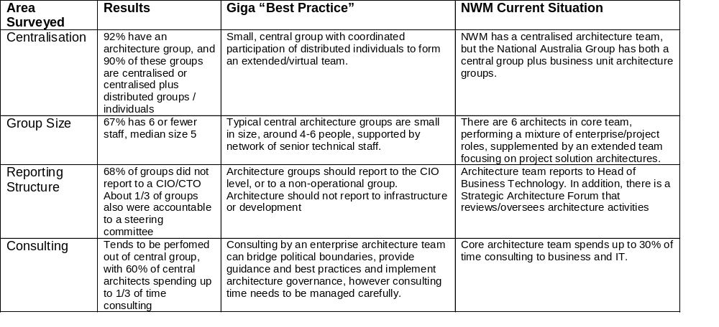
Comparing the architecture function in NWM against other organisations
The Giga Information Group* conducted a survey of enterprise architecture groups in organisations.
The 15-question survey had 26 respondents (Giga clients from around the world, various industries).
The size, role and positioning of the NWM Architecture team seems to be broadly in line with the majority of survey respondents, as well as best practices.
* Source: Giga Planning Assumption RPA-042001-00002, April 2001

Slide 10
Creating the Solution Architecture Role
A Solution Architecture is a document and project deliverable mandated for all projects …
… it is also a process by which the organisation can agree on the high level design of the solution/project …
… choosing from a list of potential options …
… plus a mechanism for ensuring that we do build to the solution in the project.
A Solution Architect is …
… a member of project team …
… resourced through Architecture team
… drives definition of an agreed and signed off solution architecture
… ensures solution progresses towards target enterprise architecture
… ensures solution is implemented in accordance to design
… covers both application and infrastructure aspects of solution, by working with other parts of the IT organization and partners
Exemptions to architecture compliance may be granted based on:
The Architecture/Standard is not deemed relevant or implementable for valid reasons.
Project is pioneering new architectures or technologies.
Compliance is judged to be non-economical (even in the longer term) AND does not compromise ability to integrate across applications.

Slide 11
Strategic Architecture Forum
Decision making body, focus is proactive rather than reactive
Membership consists of senior management across Business Technology and is chaired by the Head of Business Technology
Agrees on key strategic architecture and solution design decisions focusing on both "what" (conceptual) as well as "how" (physical/pragmatic/delivery/transition)
Syndication group for enterprise solutions
Ensure all points of view are covered in decision process, not just architecture
Link a project/component bottom up view with enterprise/strategic top down view
Ongoing input from external views/vendors to develop greater awareness and understanding of new offerings
Outward communication to business and IT on strategic positions including educational aspect
Escalation point for key issues/exemptions from architecture group
Takes a leadership role for ‘technology’ position papers

Slide 12
Solution Architects: Consulting vs Performing (as part of project team)
Consultant to project performing QA
Part of project team, doing the work
Pros
  More effective utilisation across multiple projects
  Provides “enterprise” perspective to influence designs
  Requires broad-based rather than specific technical expertise
Cons
  Lack of clarity on deliverable/measure of success
  Risk of “ivory tower” perspective
  Lack of in-depth skills or skills atrophy over time
  Potential lack of reuse of project not implementing design effectively due to lack of understanding/buy-in
Pros
  Ownership and accountable for project delivery
  Stronger relationships with team members, avoids “us and them” – better able to understand key issues
  Deliverables/measure of success easier to define
Cons
  Specialised skills hard to find or leverage across projects
  Risk of non-optimal allocation of resources
  Need to ensure link to central governance
WM Current Situation
Strategy and Architecture team play a mixture of consulting/performing roles in projects, depending on situation
Solution Architects resourced outside team tend to be part of team in a perform role.
Best Practice/Key Trends
Both Meta and Giga recommend a consulting role for enterprise architects, supplemented by an extended team drawn from application development/infrastructure that does the detailed design of various aspects of architecture.
Recommendation
Consulting/review role should be separated from perform role (Solution Architect) – both required, performed by different people
Consulting/review role should be performed by enterprise architects, supplemented by Design Review Group and ext. consultants.
Consulting role should have measurable and tangible deliverables/measures of success, eg. achievement of sign-off.
Formalise an extended architecture team to focus on Solution Architect role
Rotate people between consulting/performing roles to build balance – need to develop link/governance across both roles

Slide 13
Solution Architects: Centralised vs Distributed resources
Centralised
Distributed
Pros
  More effective utilisation across multiple projects
  Focus, progress and continuity, also career / development management (for permanent staff)
  Better reuse, knowledge sharing and compliance to enterprise architecture
Cons
  Risk of “ivory tower” perspective
  Lack of in-depth skills or skills atrophy over time
  Slower ramp up/down of resources to meet demand
Pros
  Leverages architecture skills outside centralised group
  Alignment with business unit allows fostering of specific business/domain expertise over time
Cons
  Tendency to create silo solutions due to lack of perspective
  Inhibits knowledge sharing across architects
WM Current Situation
Full-time permanent Solution Architects currently centralised within Strategy and Architecture team.
Solution Architects resourced from outside team are distributed by default (no common reporting structure outside project), and may come from different organisations
Best Practice/Key Trends
Both Meta and Giga recommend a hybrid model consisting of centralised architects supplemented by external resources with specialised/focused skills forming a single “virtual” team.
Recommendation
Formalise an extended team (centre of excellence?) of Solution Architects consisting of both Strategy and Architecture team members plus resources from project pool with Solution Architecture expertise – see appendix slide
Ensure knowledge sharing across extended team
Rotate people across enterprise and solution architect role (and also to other teams in BT) – to ensure balance between theory and practice and to develop solution architecture expertise outside of architecture team.

Slide 14
Solution Architects: Dedicated Project Resource vs limited time engagement
Dedicated (full time?) over life of project
Time limited to initial stages of project
Pros
  Ownership and accountability for delivery, not just design
  Ensure project build to architecture
Cons
  Higher project cost due to dedicated allocation
  Cannot leverage skills across multiple projects
Pros
  Leverage skills across multiple projects
  Role of Solution Architect during build and test not clear (technical team leader?)
Cons
  Less accountability for project delivery
  Risk of solution variances post design
  Risk of insufficient buy in/understanding of solution
WM Current Situation
Currently the Solution Architect’s role is limited from Feasibility to end of Detailed Design phase. Many Solution Architects only play a part time role within projects (due to project budgeting constraints, or lack of recognition of value added).
Best Practice/Key Trends
Giga recommends a time-limited consulting role for architects in projects.
Recommendation
Large projects (eg. Superstar) should have dedicated full-time solution architects responsible for overall solution up until detailed design stage, and part time role after that till completion to ensure accountability for delivery
Large programs (eg. Integra) should have dedicated “lead architect” over life of program (reporting to Program Director) – Solution architects for various projects within program should report to lead architect as well as individual project managers
Smaller projects should go for limited-time approach, to maximise leverage of skills across projects.
Amend BT estimation model to ensure solution architect cost included in estimates.

Slide 15
Solution Architects: In-house vs externally-sourced
In-house
Externally sourced
Pros
  Better knowledge of business, enterprise architecture
  Continuity and knowledge capture
  Lower unit cost
Cons
  Need to be budgeted for (but charged out to projects)
  Less flexibility in managing supply/demand
  Specific skills difficult to source/retain
Pros
  Access to and leverage (potentially rare or specialised) skills available in marketplace
  Easier to manage supply and demand
Cons
  Higher unit cost (per project)
  Lack of continuity and potential loss of knowledge
  Difficult to enforce enterprise architecture governance, learning curve required
WM Current Situation
Highly leveraged model consisting of small number of permanent staff/contractors, supplemented by use of resources from external consultants.
Best Practice/Key Trends
Meta and Gartner recommends in-sourcing architects as in-house resources are better placed to understand the business context and endowed with the sense of ownership to make the difficult trade-offs. Giga recommends leveraging the use of external service providers to provide access to specialised skills, industry knowledge and methodologies (where appropriate).
Recommendation
Continue with a leveraged model consisting of both internal and external resources, but build up internal capability for Solution Architects. Use external resources to bring in new ideas/ways of thinking/research.

Slide 16
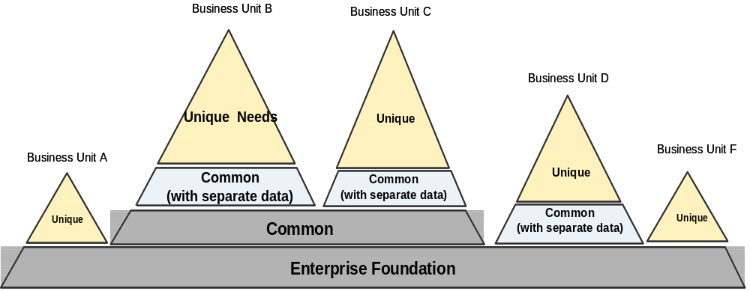
Federated Architecture Model
One size does not fit all - Technology variation across business units within the National, driven by each unit’s specific objectives, resources and priorities.
Focus of architecture governance - Ensure common standards are defined and successfully applied across the group for elements of ‘common’ or ‘foundation’ building blocks.
Proposed solutions need to be assessed against the overall architecture to determine if they are leveraging, contributing or duplicating components.
Standards for the ‘common’ or ‘foundation’ layer are documented and communicated.
Notes:
The Federated Model recognizes the reality that one size does not fit all and that technology variation is necessary and even desirable across business units within the National, driven by each unit’s specific objectives, resources and priorities.
The focus of architecture governance within a Federated Architecture is to ensure that common standards are defined and successfully applied across the group where it makes sense to do so, particularly for elements that have group wide implications and can be considered to make up the ‘common’ or ‘foundation’ building blocks within the overall architecture landscape.
Within a Federated Model, proposed solutions need to be assessed against the overall architecture to determine if they are leveraging, contributing or duplicating components.
Where standards have been established for components considered to be part of the ‘common’ or ‘foundation’ layer of the overall Enterprise Architecture, these are documented and communicated.

Slide 17
Architecture Domain Model
Group Enterprise Architecture Leadership Team
CT
Architecture
Lead
FSA
Architecture
Lead
CIB
Architecture
Lead
BNZ
Architecture
Lead
WM
Architecture
Lead
FSE
Architecture
Lead
Enterprise
Architecture
Strategy
Assumptions:
  The business unit architecture leads and the enterprise architecture strategy team make up the Enterprise Architecture leadership team
  Solution architects are aligned to competency domains, e.g. application architecture
  Solution architects are aligned to business line domains, e.g. retail, insurance, distribution
  Solution architects are aligned to IT asset domains in AD/M, e.g. product admin systems, e-business
  The aligned disciplines are expected to require 30% of the solution architects time
  Solution architects are assigned to a project delivery domain, e.g. Amazon, Technology refresh
Solution Architect
Competency Domain
Architecture Competency
Business Line Domain
30% Funded By
WM Architecture budget
Business Line
IT Asset Domain
IT Asset
Project Delivery Domain
70% Cost Recovery
from Projects
Solution Architecture
Note: percentages will vary across business units

Slide 18
Funding and Recharge Model
Assumptions:
  Dedicated resource acting as architecture manager
  Core architecture team consisting of dedicated resources independent of demand
  All projects are required to have a solution architect
  70% of the core team resource costs to be recovered from the projects to which they are assigned
  When demand for architecture resources are in excess of the core team, additional resources are to be added to address the gap
  100% of the additional resource costs to be recovered from the project that originated the resource request
  Additional resources could be National employees or external consultants
Funding Shortfall
FTE’s
Additional
Resources
Temporary Roles
5
Core Team
Demand
Role | FTE’s | Funded | Recovered | Overhead
Team Lead | 1 | 100% | 0% | 1
Core Team | 6 | 30% | 70% | 2
Additional | 5 | 0% | 100% | 0
Total | 12 | 25% | 75% | 3

Slide 19
Summary: Lessons Learnt
Be wary of consultants and vendors
  Vendor architectures are often proprietary and designed for “lock in”
  However, if the shoe fits, wear it! (Otherwise you end up having to build everything)
  Consultants are armed with methodologies, but the end of the day their role is to facilitate, not create
  Industry models and “canned” architectures are useful … as a starting point
  Once you have a process and a framework in place, try and avoid consultants “re-inventing the wheel” with a new methodology, but extend what is already there
Architecture is a competency, not a function
  Ideally, everyone in the IT organization should have architecture skills, like project management or requirements analysis
  The role of the architecture team is to facilitate and consolidate architecture efforts
Start small and grow
  Don’t try to solve world hunger and populate every box in the Zachmann framework simultaneously
  Focus on the key aspects, and continually build on previous work
  Use iterative or stepwise refinement techniques
  However, don’t be afraid to throw away and start again
Align with everything
  Make sure you can relate and trace architecture artefacts to business strategy, industry models, other organizations/divisions, consultant frameworks
  Alignment can happen both ways, don’t be afraid of telling the business strategy people they are wrong, or have missed something (but do it nicely!)
Communicate, communicate, communicate
  Designing a model, architecture or solution is the easy bit
  The hard bit is convincing the organization that you are right
  The even harder bit is ensuring that what is built is what’s designed

